Slide 1
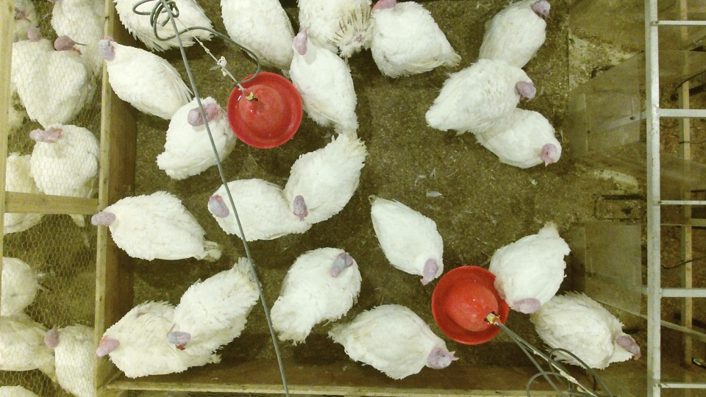
Animal Tracker

Slide 2
The question consists in tracking the turkeys that are inside the pen. The pen is what is inside the blue area. The Red is also important because I need to know when the animals are inside the red area. A Part from the red and blue areas the rest of the image is not accesible for the animals.

Slide 4
Project - Animal Tracker

